Slide 1
Digital protfilio
Name : t.Arunachalam
Register no :222404613
Nmid:FDB91452AB320F98BEF4DFB9E6BC5228
Department: Bsc cs(Ai) specialization
College :agurachand manmull jain college / Madras University afillated

Slide 2
Project title;
My Digital Portofolio

Slide 3
Agenda ;
Problem Statement Project Overview End Users Tools & Technologies Portfolio Design & Layout Features & Functionality Results & Screenshots Conclusion GitHub Link

Slide 4
Problem statement :
Fresher's often lack a professional online space to present their skills, projects, and certificates. Traditional resumes are static and difficult to update. A digital portfolio solves this by creating a single, shareable, and responsive platform. This improves visibility, credibility, and opportunities.

Slide 5
2. Project Overview :
The project is a responsive personal website designed to showcase identity, education, skills, certificates, and projects. It is simple to navigate and visually professional. The website includes sections for About, Skills, Projects, and Contact.

Slide 6
3.End user
The website mainly targets recruiters, hiring managers, and placement officers. They can view skills, certificates, and resumes at a glance. Faculty members can review achievements and progress.

Slide 7
4. Tools and technologies :
The website was developed using HTML, CSS, and JavaScript. GitHub was used for version control and deployment. VS Code was the main code editor. The site is hosted online for accessibility. These tools ensure a responsive, lightweight, and professional output.

Slide 8
5.Website Design & layout :
The design is clean and simple with easy navigation. The navigation bar includes Home, Certificate, Resume, and Contact links. The Home . The About section highlights education, skills, and location. A profile photo is also included for personalization.

Slide 9
6.futFeatures & Functionality
The site includes a professional dashboard with personal information. Certificates are showcased in a structured format. The Resume can be downloaded directly. The layout is responsive, making it work on desktops and mobiles.

Slide 10
7.Result & screenshot :
The website successfully presents personal and academic details. The Contact page allows direct interaction. Screenshots show the dashboard, certificates, and resume sections clearly.

Slide 11
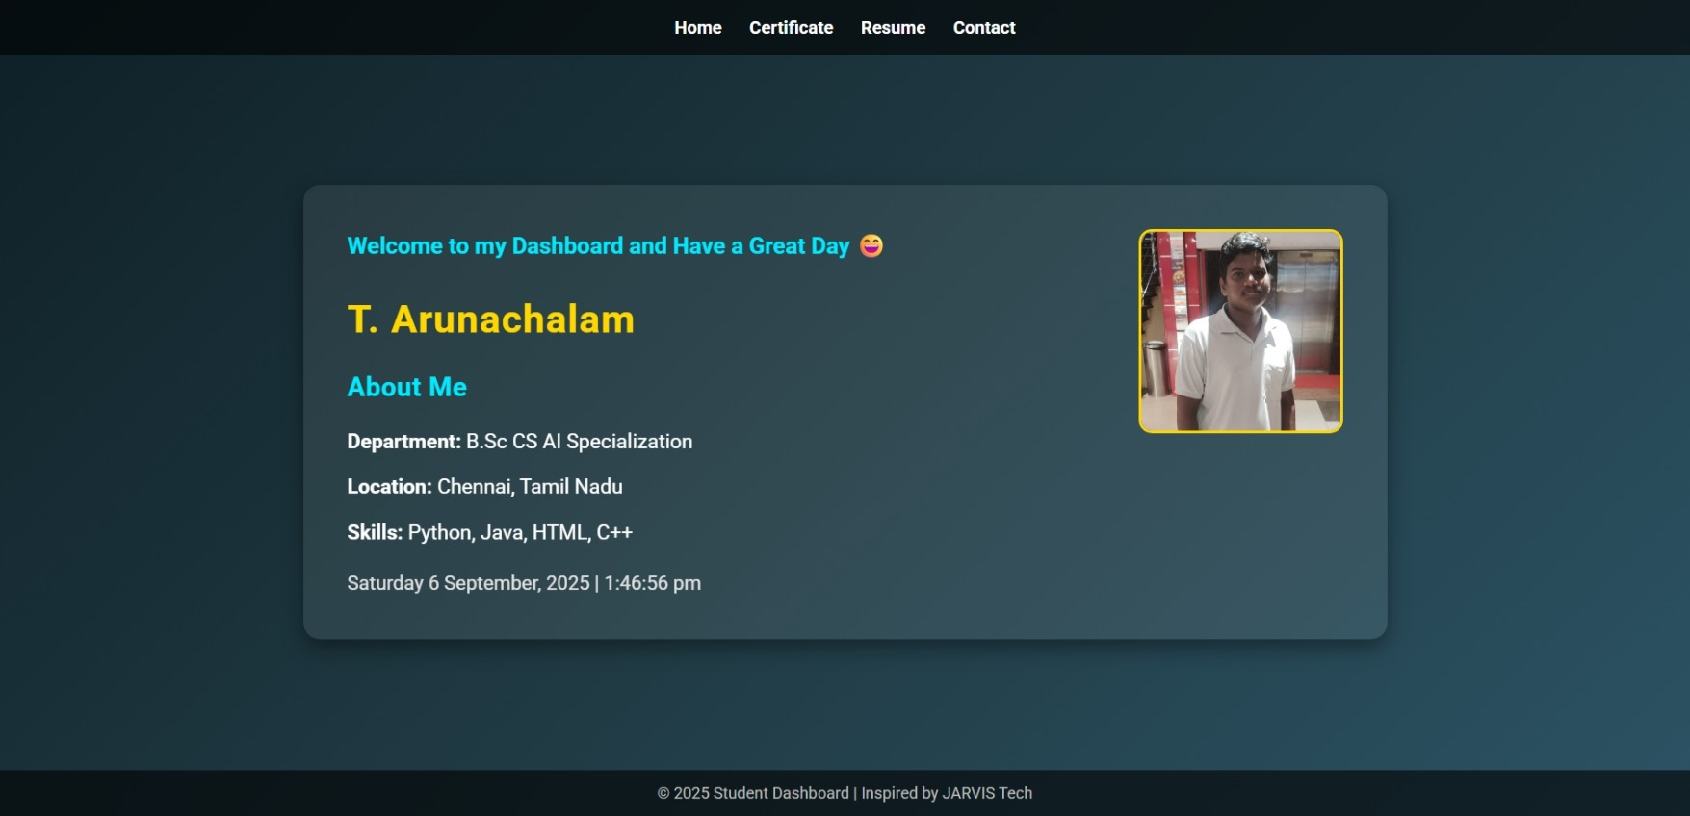
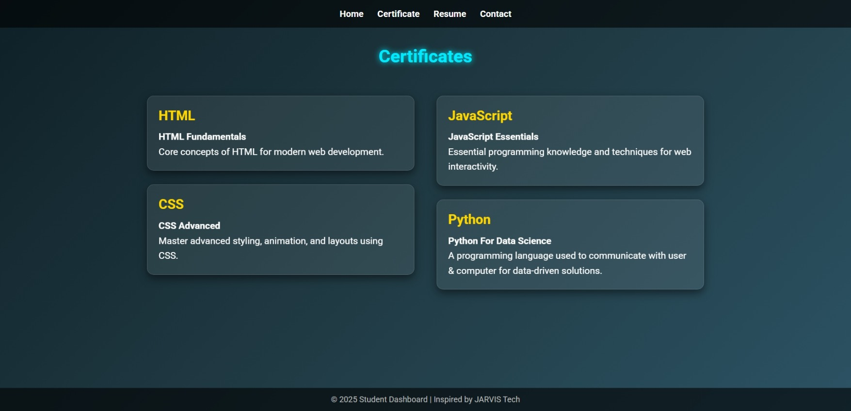
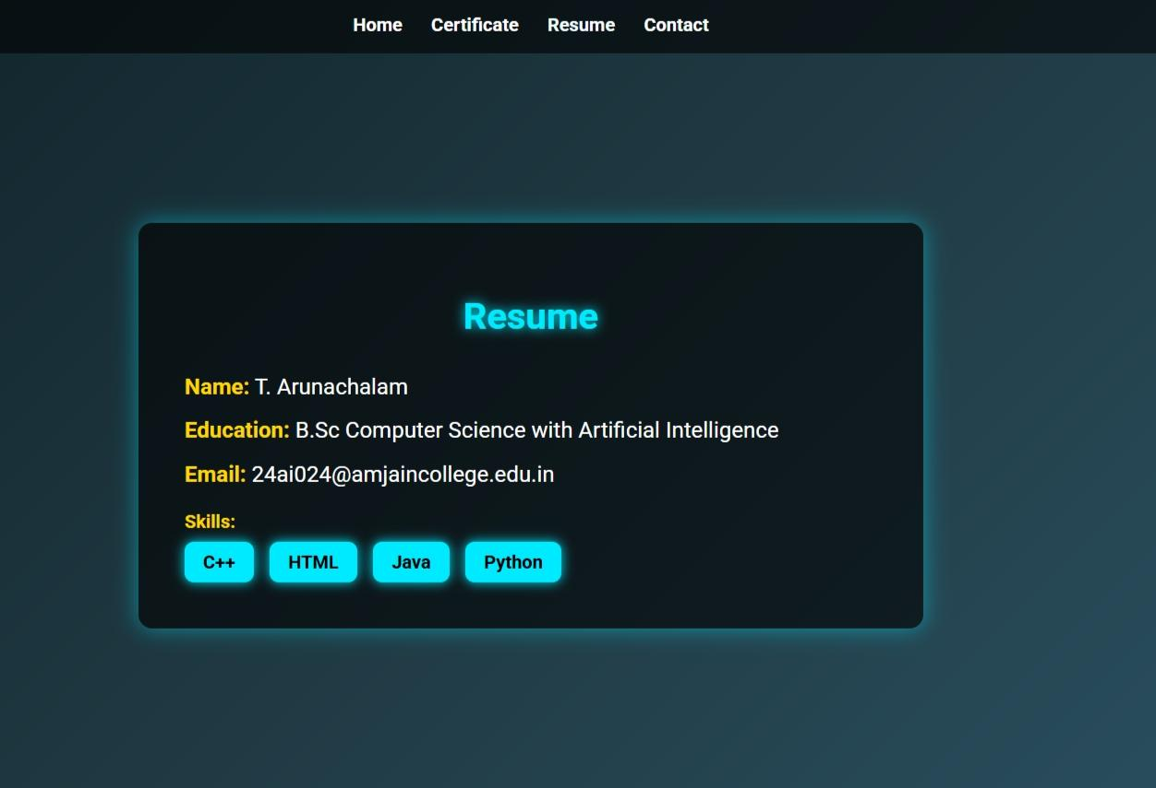
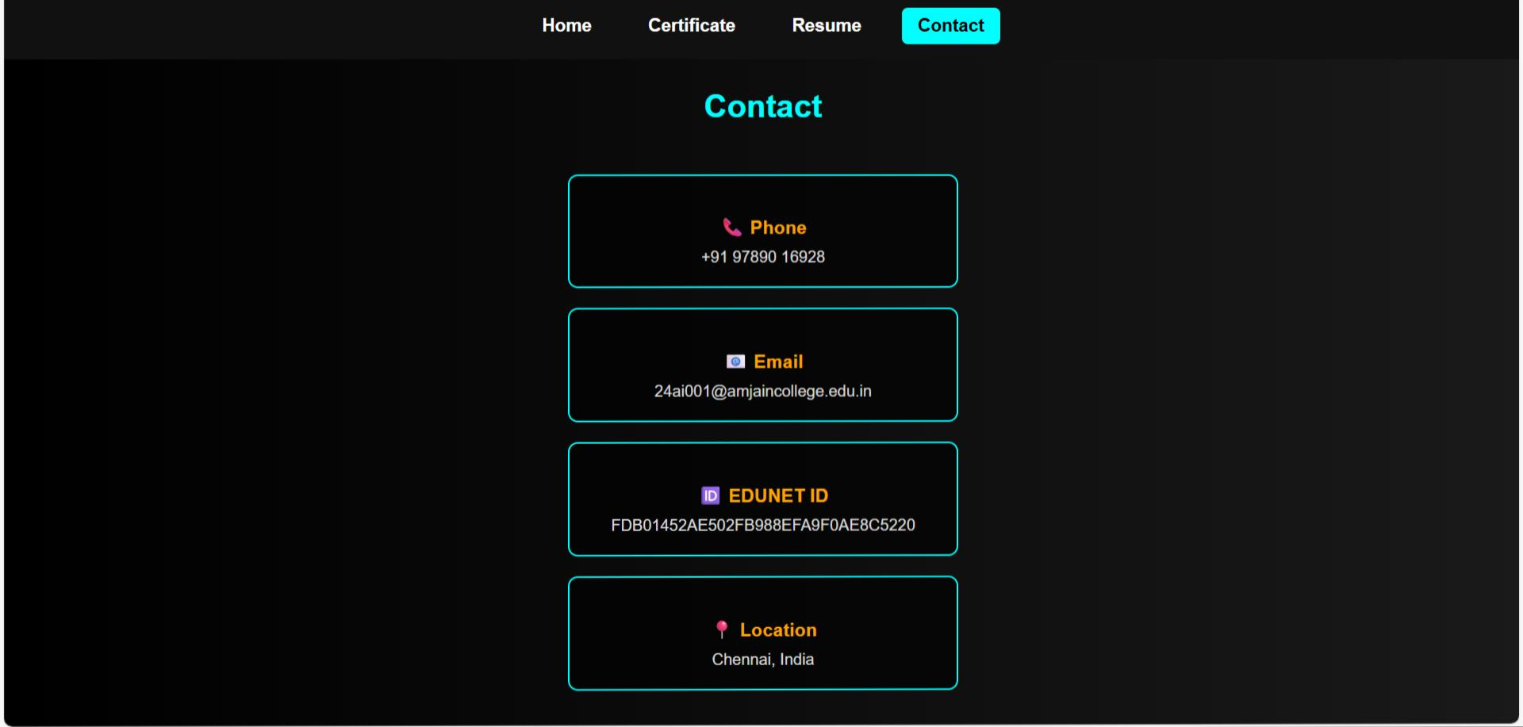
7.Result & screenshot:

Slide 12
8.conclusion:
The personal website provides a complete digital portfolio. It centralizes skills, certificates, and resume in one place. The site is easy to update and maintain. Future improvements can include blogs and project showcases.

Slide 13
9.Github link:
This is my digital portfolio link
https://arunachalamthirumalai552-dot.github.io/nan-mudhalvan

